Slide 1
leave
I am leaving for a trip.

Slide 2
lake
I love to swim and fish at the lake.

Slide 3
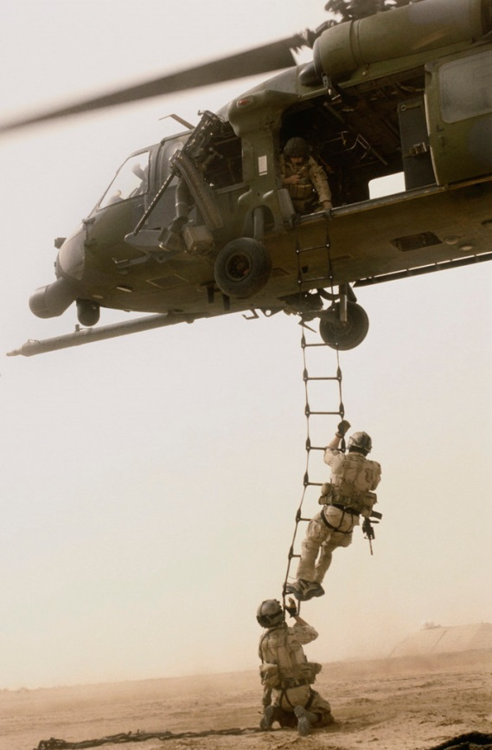
brave
The soldiers have to be brave.

Slide 4
waiter
The waiter brought us our food.

Slide 5
Fin
I see a shark’s fin in the water.
I used my new snorkel and fins to swim.

Slide 6
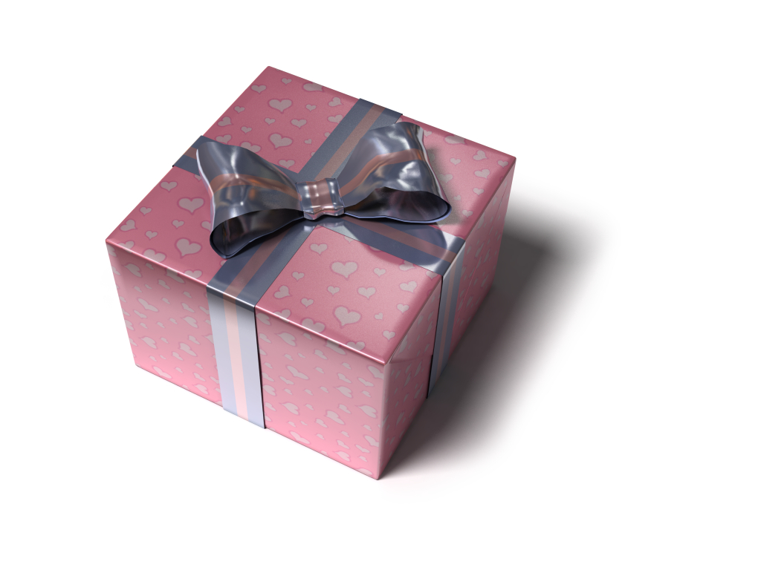
gift
I love to open gifts on my birthday.

Slide 7

decorate
We like to decorate the tree.

Slide 8
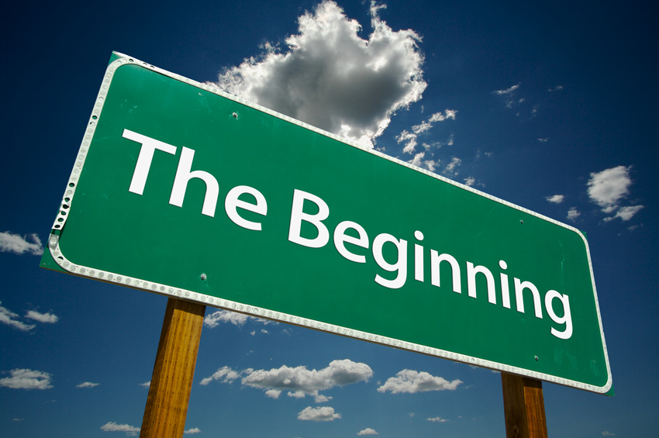
begin
The runners will begin the race.

Slide 9

flame
The flames of the fire are hot.

Slide 10
toad
The toad is in the pond.

Slide 11
yawn
I yawn when I’m tired.

Slide 12
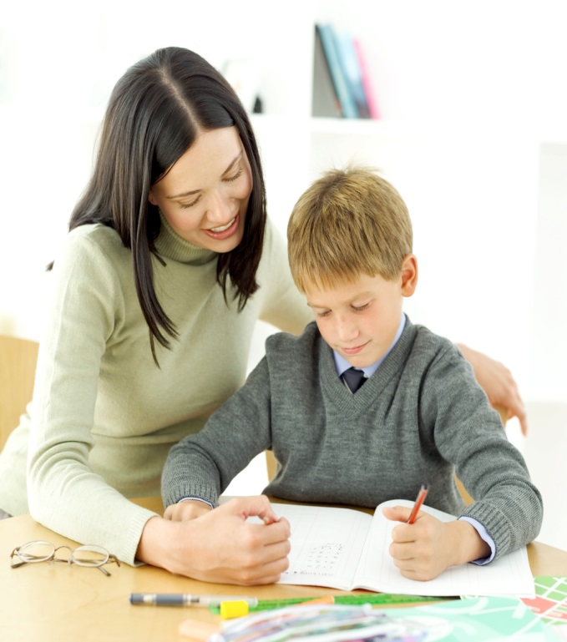
beside
The teacher is beside the student.

Slide 13
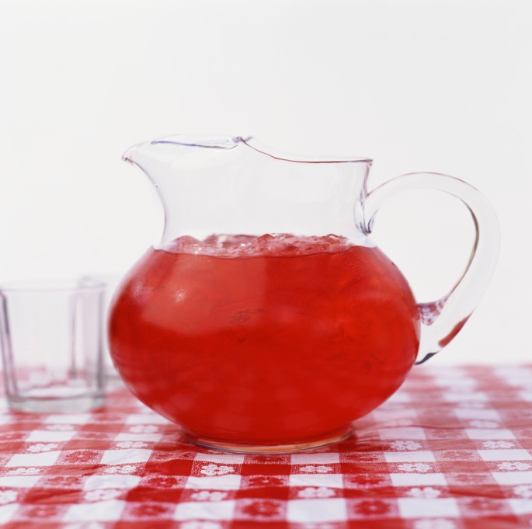
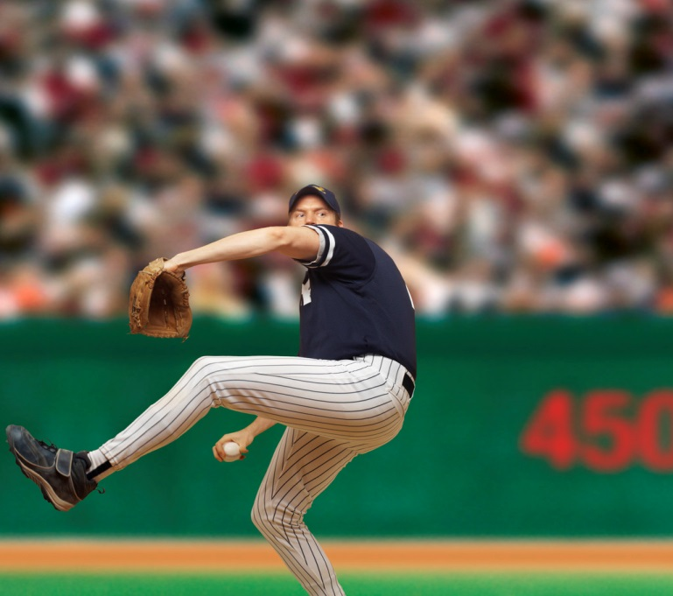
pitcher
My mom made a pitcher of tea.
The pitcher threw the baseball.

Slide 14

Binoculars
I used binoculars to see the animals at the zoo.

Slide 15
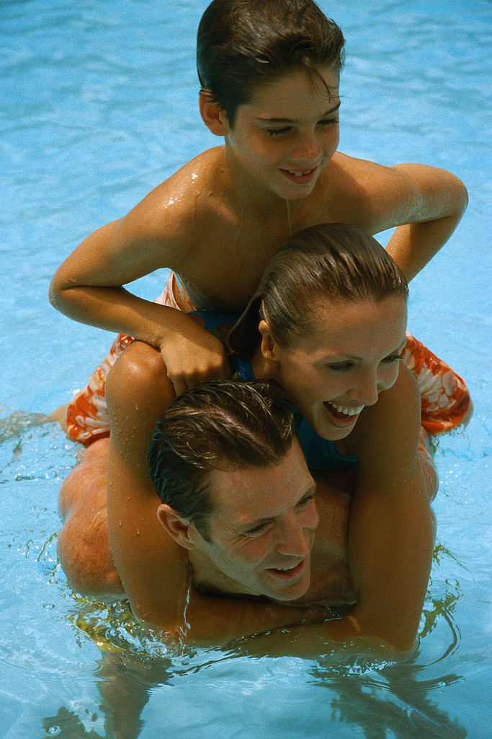
behind
The boy is behind his mom and dad.

Slide 16
thief
The thief robbed the bank.

Slide 17

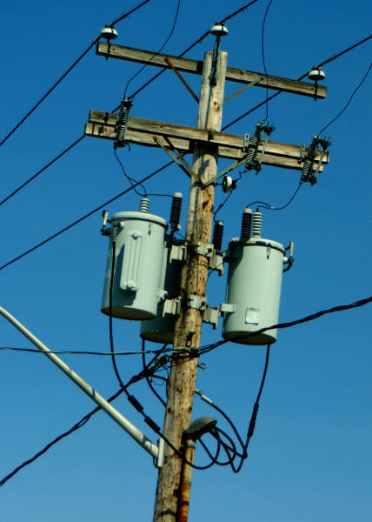
Energy
Electricity is a form of energy.
You need to have a lot of energy to run.

Slide 18
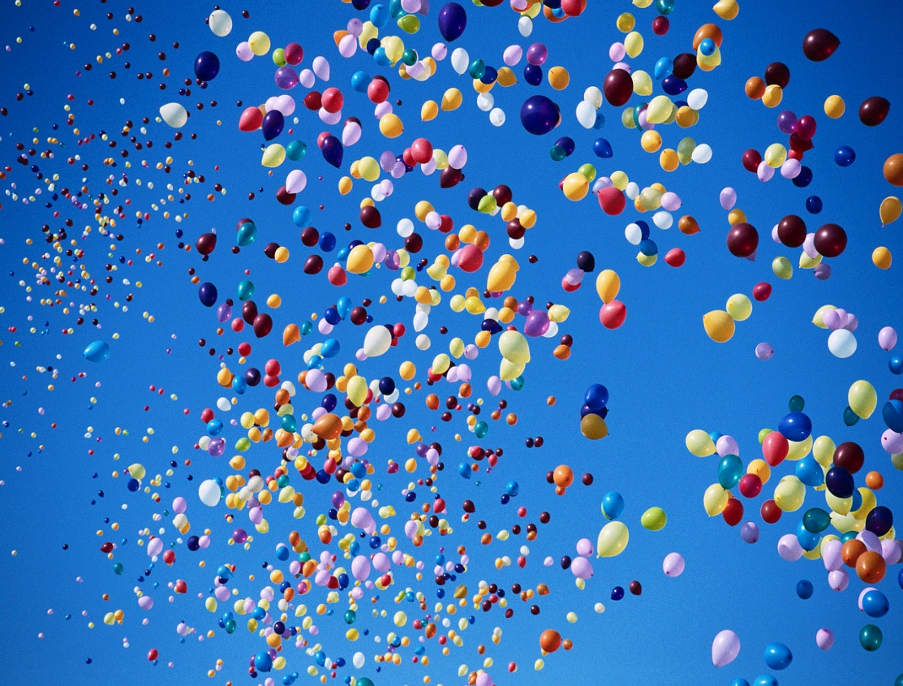
marvelous
The balloons looked marvelous in the sky.

Slide 19
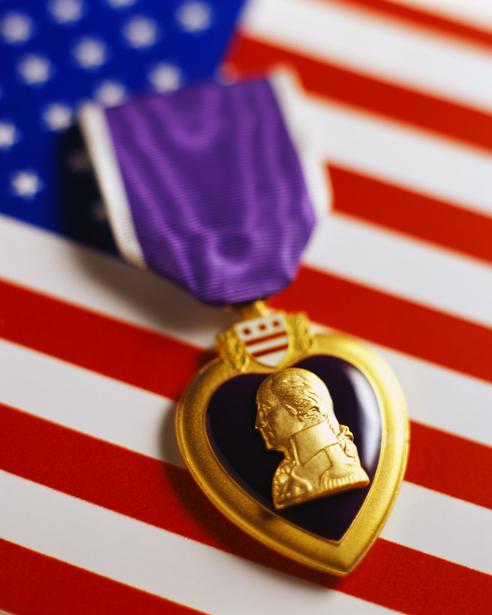
honor
The Purple Heart is an honor for our soldiers.

Slide 20
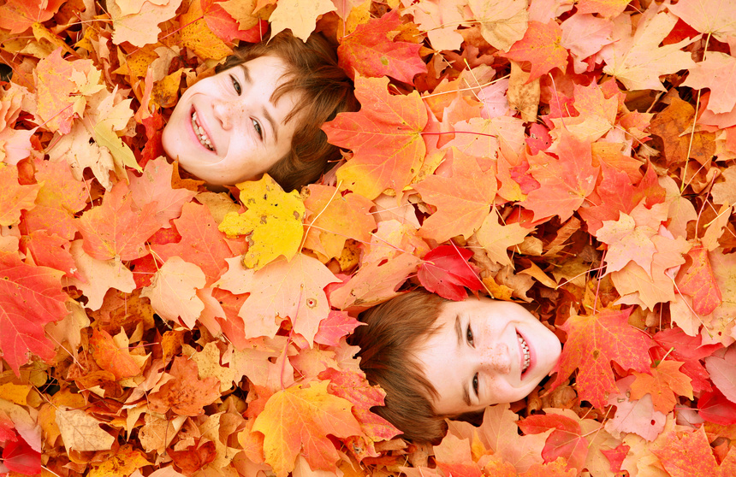
autumn
Autumn is my favorite season.

Slide 21
circulate
The fan circulates the air in the room.

Slide 22
distant
The planets are distant from Earth.
The stars sparkle.

Slide 23
error
My computer says I made an error.
It is difficult to fix a computer.

Slide 24
familiar
The twins are familiar with each other.
The twins are identical.

Slide 25
defend
The lawyer will defend you in court.

Slide 26
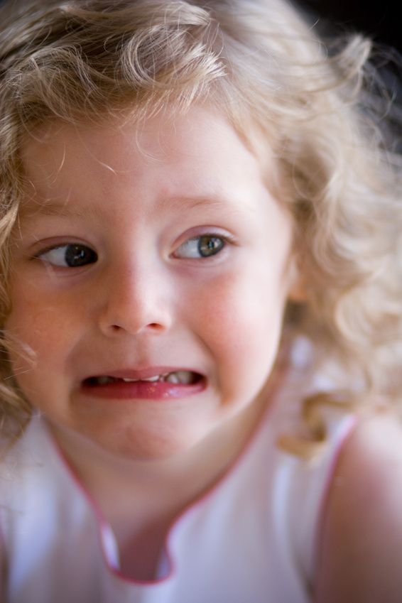
tremble
I tremble with fear when I see a spider.

Slide 27
heal
The cast will help my arm heal.

Slide 28
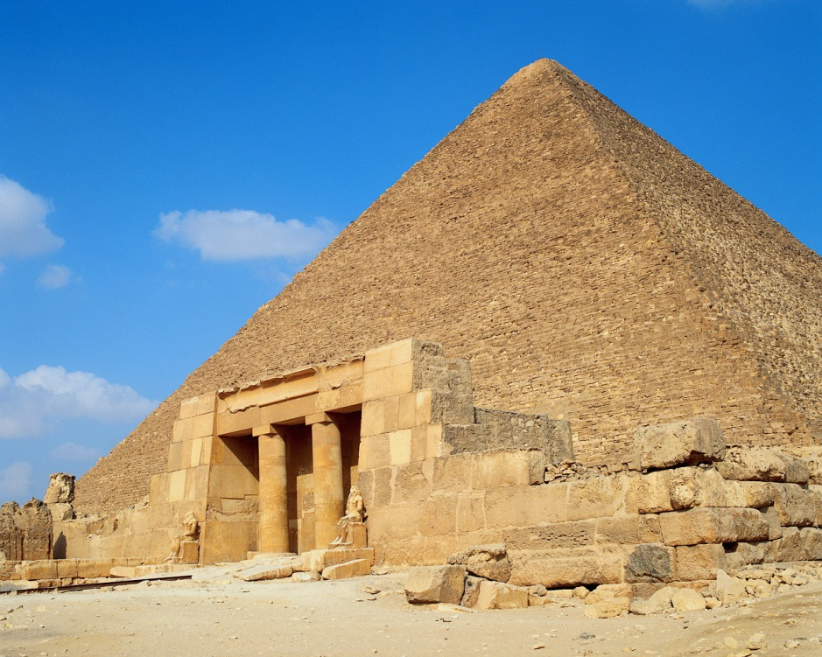
ancient
The pyramids in Egypt are ancient.

Slide 29

contain
My bag contains a lot of money.

Slide 30
terrify
The mouse will terrify my teacher.

Slide 31
ruin
I didn’t mean to ruin the bottle.

Slide 32
equal
Two plus two equal four.

Slide 33
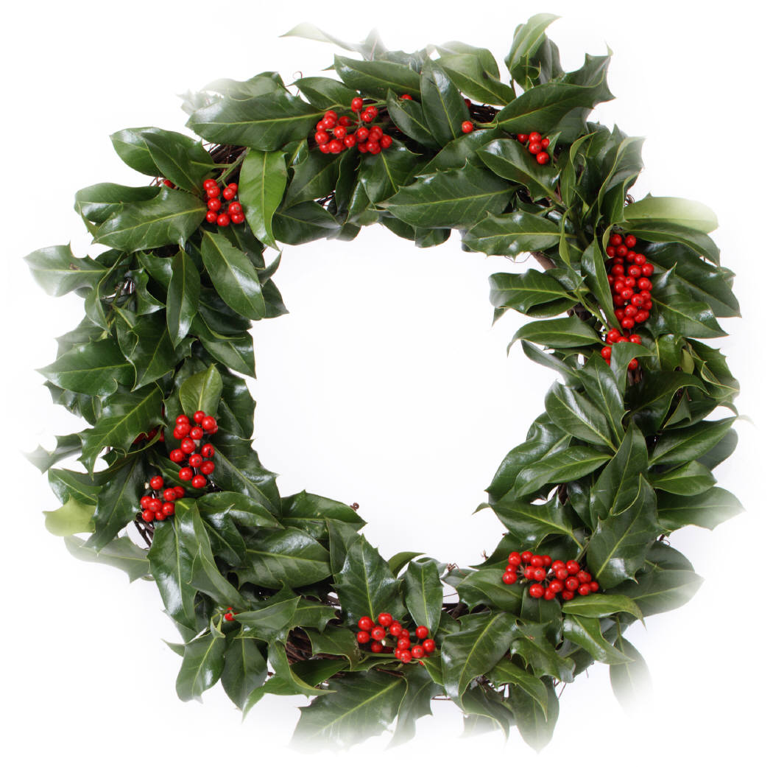
wreath
I hung a wreath on the door at Christmas.

Slide 34

pain
I feel pain on my knee.

Slide 35
under
I put the present under the tree.

Slide 36
correct
I will correct my paper to get a good grade.

Slide 37
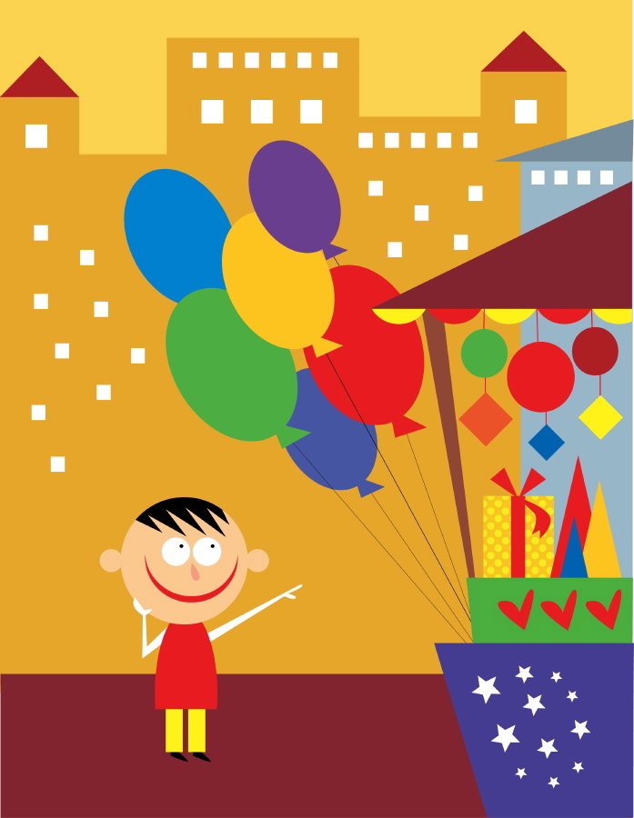
glad
I am so glad I won a prize.

